Slide 1

Network Port Scanner
Kanishka K
STU68766a45e51e81752590917
Seshadripuram Degree College

Slide 2

PROBLEM STATEMENT
A lot of people who are just starting out and small organizations do not have access to tools to check open ports in a network.
This project is about making a network port scanner that is easy to use. The network port scanner will help network port scanner users see which ports are open and which are closed without needing to know a lot, about technology.

Slide 3
Project Description The Network Port Scanner is a project made with Python. It checks if certain ports on a system are open or closed. It teaches them about networks and basic cybersecurity concepts in a way that's easy to understand.

Slide 4

WHO ARE THE END USERS?
People who are learning about networking or cybersecurity are the users.
Beginners who want to learn about hacking.
Developers

Slide 5

Technology Used
Python
Windows
Port scanning

Slide 6
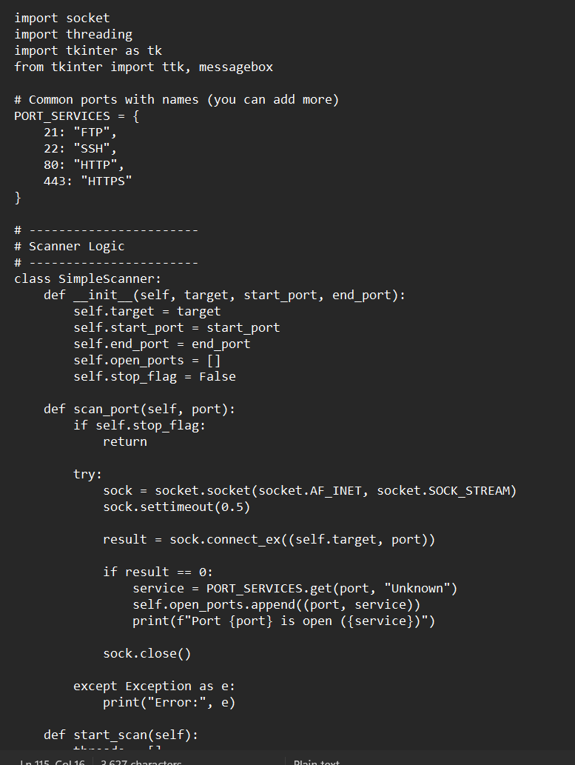
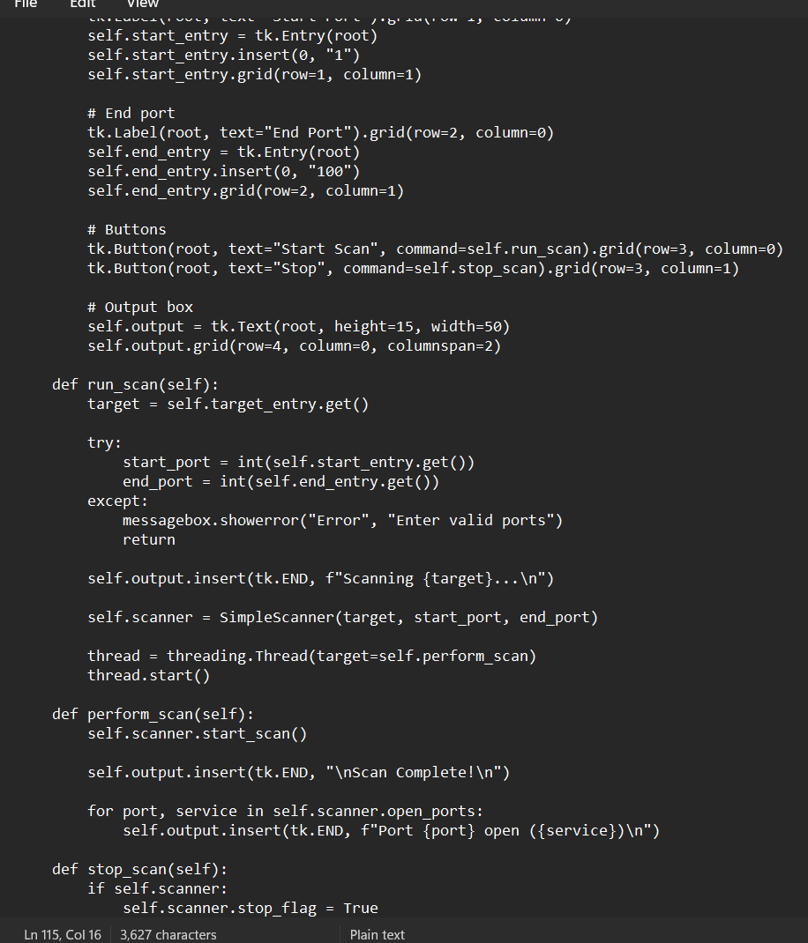
RESULTS
https://github.com/kanishkakurukuri/Network-Port-Scanner

Slide 7
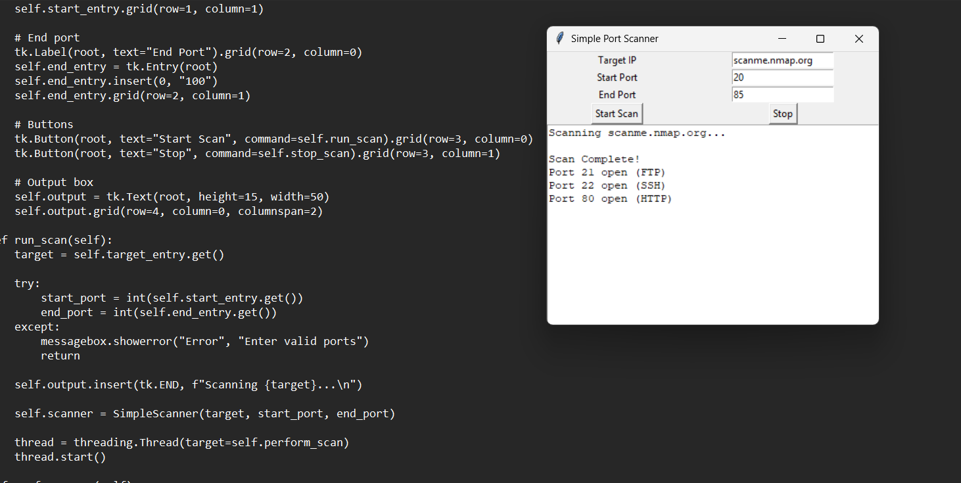
RESULTS
https://github.com/kanishkakurukuri/Network-Port-Scanner

Slide 8

Certificate - Protection from browser attacks

Slide 9

Certificate - Introduction to System Security

Slide 10
GitHub link
https://github.com/kanishkakurukuri

Slide 11
Thank you
.
.

